Slide 1
Media Access Methods

Slide 2
Shared Medium in a LAN
Shared medium used for all transmissions
Only one station transmits at any time
Stations “take turns” using medium
Media Access Control (MAC) policy ensures fairness

Slide 3
Media Access methods
Access methods: Mechanisms put in place to control access fairly when several entities share the same communications medium (channel).
Access methods use a certain amount of the channel's bandwidth for access control.
The usable portion of the channel's bandwidth is limited by the access method being used.
  Each method has a different effect on network traffic.
Include
  Polling
  Contention
  Token-Passing

Slide 4
Polling
Most closely associated with mainframe (point-to-point) computer networks.
One device e.g. a mainframe front-end processor is designated as the primary device
  Primaries also are known as the channel access administrators, controllers, or masters.
All access to the network is controlled by the primary.
The primary queries (polls) each of the secondary devices (also known as slaves)

Slide 5
Polling
In this process, the primary inquires if the secondary has information to be transmitted.
The secondary has access to the communication channel only when it is polled.
Each system has rules pertaining to how long each secondary can transmit data.
Polling can be utilized in virtually any network topology.

Slide 6
Benefits of Polling
Many characteristics can be determined centrally, including the polling order and node priorities.
Polling is deterministic.
  Channel access is predictable and fixed.
  Suitable for controlling some automated equipment
Channels cannot be over saturated with traffic.
  As demand increases, traffic increases up to a maximum level.
  The polling mechanism ensures that maximum traffic level cannot be exceeded - excess traffic does not reduce the performance of the network.

Slide 7
Limitations of Polling
Some applications cannot function with the time delays required for polling other devices.
The process involves large numbers of messages that take up available bandwidth.
  Traffic is required to poll each node, even idle nodes
In half-duplex transmission, primary and secondary devices must "turn around" the line, requiring some bandwidth.
Polling requires a sophisticated central control mechanism that requires extensive configuration.

Slide 8
Contention
Also known as random access.
Unlike polling and token passing, there is no fixed order in which the nodes can transmit.
Any device can transmit whenever it needs to send information.
To avoid data collisions, specific contention protocols were developed requiring the device to listen to the cable before transmitting information.
They include carrier sensing with collision detection and collision avoidance.

Slide 9
CSMA/CD Paradigm
Multiple Access (MA)
  Multiple computers attach to shared media
  Each uses same access algorithm
Carrier Sense (CS)
  Wait until medium idle
  Begin to transmit frame
Simultaneous transmission possible

Slide 10
CSMA/CD Paradigm
Two simultaneous transmissions
  Interfere with one another
  Called collision
CSMA plus Collision Detection (CD)
  Nodes transmit at any time; no time slots
  Nodes never transmit when any other node is transmitting; uses carrier sensing.
  A node stops transmission as soon as it detects another node transmitting; collision detection.
  The nod waits for a random time before attempting retransmission
    Typically small compared with frame transmission time.

Slide 11
Backoff After Collision
If the node senses the channel is idle, it starts to transmit a frame.
If the node detects a busy channel it waits until it senses no signal.
When collision occurs, the node transmits a 48-bit jam signal and enters exponential backoff
  The node then waits for a period of time and then attempts to retransmit.

Slide 12
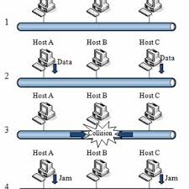
CSMA/CD flow diagram

Slide 13
CSMA/Collision Avoidance
Used on wireless networks
Both sides send small message followed by data transmission
  “X is about to send to Y”
  “Y is about to receive from X”
  Data is sent from X to Y
Purpose: inform all stations in range of X or Y before transmission
Known as Collision Avoidance (CA)

Slide 14
Benefits of Contention
Contention is a very simple access method that has low administrative overhead requirements.
No network traffic is necessary to manage the access scheme.
Actual user data throughput is rather high at low traffic levels in comparison to the total amount of utilized network bandwidth.

Slide 15
Limitations of Contention
At high traffic levels, data collisions and the resulting retransmission diminish performance dramatically.
  It is theoretically possible that collisions can be so frequent at higher traffic levels that no station has a clear chance to transmit.
Channel access is probabilistic rather than deterministic.
Some automated equipment that cannot tolerate delays cannot use this type of access.
  Contention offers no means of establishing the frequency of a station's opportunities to transmit.

Slide 16
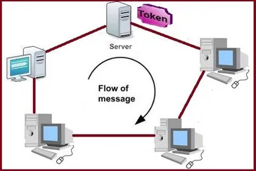
Token Passing

Slide 17
Token Passing
Uses a special authorizing packet of information to inform devices that they can transmit data.
These packets are called tokens and are passed around the network in an orderly fashion from one device to the next.
Devices can transmit only if they have control of the token.
This method distributes the access control among all the devices.

Slide 18
Token Passing
Two approaches to token passing are available.
  Using a ring topology: Each station passes the token to the next station in the ring.
  Using a bus topology: Each station passes the token to the station with the next higher node address, regardless of its physical location on the network.

Slide 19
Advantages of Token Passing
Token passing offers the highest data throughput possible under high traffic conditions.
  No collisions - less performance degradation at higher traffic levels than contention.
Token passing is deterministic.
Some token passing systems enable setting of priorities for devices that need controlled access to the token.
As the traffic increases, data throughput also increases to a certain level, and then stabilizes.

Slide 20
Disadvantages of Token Passing
Token passing involves complicated protocols for managing the network and recovering from errors.
  The traffic associated with this protocol has higher band width overhead then is required for CSMA.
It require complicated software that needs to be modified whenever a station is added or removed.
May require an additional central controller that adds to the overhead and reduces throughput.
Cabling and hardware can be more expensive for token passing networks than for CSMA networks.

Slide 21
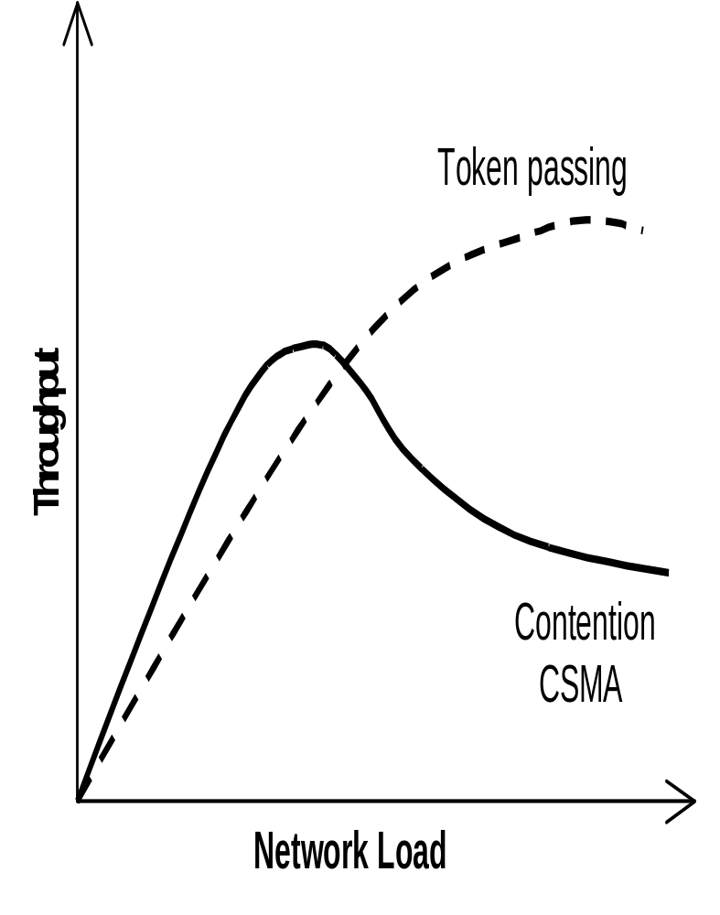
Performance Comparisons
Token passing and CSMA, the most common access methods used in LANs, have different performance characteristics (see the graph).
Load: Represents the demand being placed on the network.
Throughput: Represents the data actually being transmitted

Slide 22
Performance Comparisons
The throughput of a CSMA network rises smoothly with increased traffic levels up to a point.
  At that point, collisions begin to occur with greater frequency, resulting in a gradual reduction in network throughput.
  At some point, network throughput reaches unacceptably low levels.

Slide 23
Performance Comparisons
Token passing exhibits reduced performance at lower traffic levels than CSMA.
  The of the many administrative mechanisms required for token access.
Throughput rises smoothly until the network is fully utilized.
  It does not degrade because no collisions can occur.
  Beyond the plateau, all workstations are sharing a strictly limited bandwidth.
  Although total throughput remains stable, the bandwidth available to a given station diminishes as demand increases.

Slide 24
Combining Architectures and Access Methods
CSMA technologies are only applicable in networks that are logical buses.
  This is the case, because each station must be able to sense all network traffic to determine if the network is busy.
On a ring network, a node can detect only the data transmissions that happen to pass it, and cannot determine whether traffic exists elsewhere on the network.
  CSMA is, therefore, not applicable to rings.

Slide 25
Combining Architectures and Access Methods
On the other hand, the only access method that works with logical rings is token passing.
  This is the case because each station must be able to receive each packet it transmits after that packet travels around the logical ring.

